Slide 1
Handwritten Digit Recognition
Liyan Chen lchen39@stevens.edu
Shangxing Jiang sjiang25@stevens.edu

Slide 2
INTRODUCTION
Handwritten digit recognition has been widely applied in many fields:
check verification,
postal address reading in envelop.
pin code recognition
Handwritten digit recognition is more difficult than printed digits, due to the unique writing style of different people.

Slide 3
Related work
· 2012, Niu and Suen，CNN +SVM，
recognition rate：94.40%
· 2014，Ravi and Venkateswarlu，KNN，
recognition rate：96.94%
· 2015, Eva and Nebojsa，SVM(OVO),
recognition rate： 99.05%
· 2016, Yan and JunMin,Ncfm (No combination of feature maps),
recognition rate： 99.81%
· 2017, Tohidul and Ghulam, CNN,
recognition rate： 99.60%

Slide 4
Source of Dataset
MNIST digit database:
Encode every image of handwritten digit into 784 pixels (28*28) with a label.
Every pixel is a gray-level value from 0 to 255 (8-bit-deep), representing the extent of color.
60000 instances for training（American Census Bureau employee）, 10000 instances for testing（ American high school students ）.

Slide 5
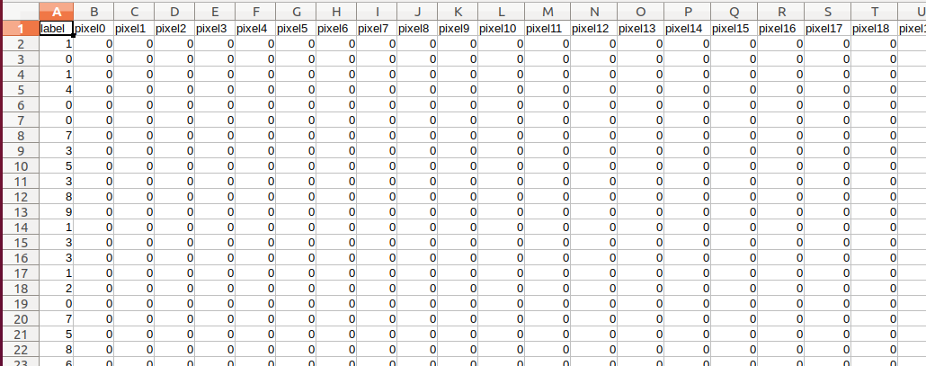
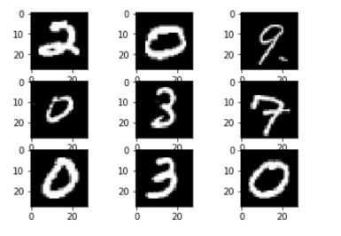
train set.csv (109.5 MB)
train label.csv (120 KB)
test set.csv (18.3 MB)
test label.csv (20 KB)

Slide 6
Extraction of Dataset
Extract 10000 samples randomly from MNIST digit database as training data, where the number of every digit (0~9) is 1000.
Extract 2000 samples as testing as well as above.
Split the testing dataset to ten files (0~9), which is used to test the accuracy of a certain digit.

Slide 7
KNN
Each sample in dataset can be seen as a vector with size of (1, 784). Supposed α and β are both Ndimensional vector, to calculate the Euclidean distance of this two vectors, a equation can be used:

Slide 8
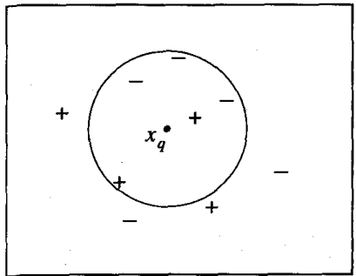
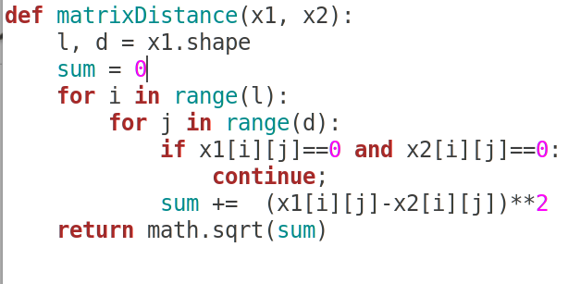
KNN

Slide 9
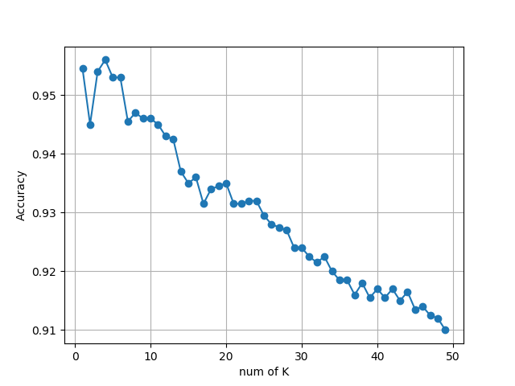
KNN
K=4, best, 95.6%

Slide 10
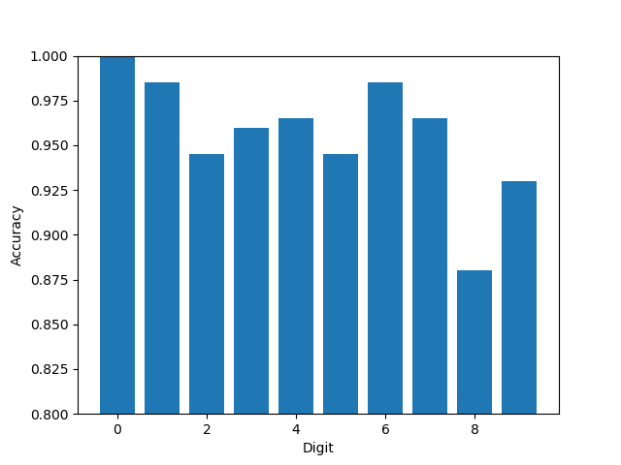
KNN

Slide 11
SVM
For handwritten digit recognition, SVM needs to get multiple hyperplanes to get 10 categories.
Here we chose a classification strategycalled one-vs-rest (OVR). Only one digit category is treated as positive example in each classification when the rest are all negative.
For this test, we imported the SVM model from sklearn and parameters were set as following: C=100.0, kernel=poly, gamma=0.03.

Slide 12
test dataMat shape: (980, 784) test dataLabel len: 980
Recognition 0 spent 7.0068s
errorCount: 8
computing score spent 7.5406s
score: 0.991837
error rate is 0.008163
---------------------------------------------------------
test dataMat shape: (1135, 784) test dataLabel len: 1135
Recognition 1 spent 8.9315s
errorCount: 9
computing score spent 9.6033s
score: 0.992070
error rate is 0.007930
---------------------------------------------------------
test dataMat shape: (1032, 784) test dataLabel len: 1032
Recognition 2 spent 7.5508s
errorCount: 26
computing score spent 7.1265s
score: 0.974806
error rate is 0.025194
---------------------------------------------------------
test dataMat shape: (1010, 784) test dataLabel len: 1010
Recognition 3 spent 7.0013s
errorCount: 23
computing score spent 7.0816s
score: 0.977228
error rate is 0.022772

Slide 13
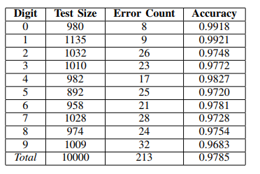
SVM

Slide 14
Weak Point
Tedious computation task.
Can’t well explain the output（extract features）
KNN：
Lazy learning
When the training sample of different catagories is not equal, k-nearest neighbors of a new example may have greater probability to be the majority catagory.
SVM：
Lack of data sensitivity
really relies on the choice of Kernel function

Slide 15
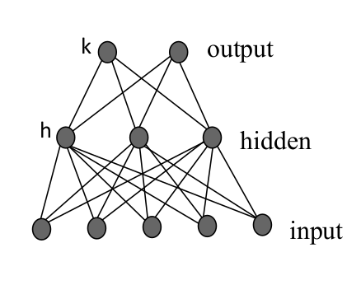
ANN
Backpropagation Algorithm
One binary output (sigmoid function)
10 to 100 units (sigmoid function)
28*28 pixel

Slide 16
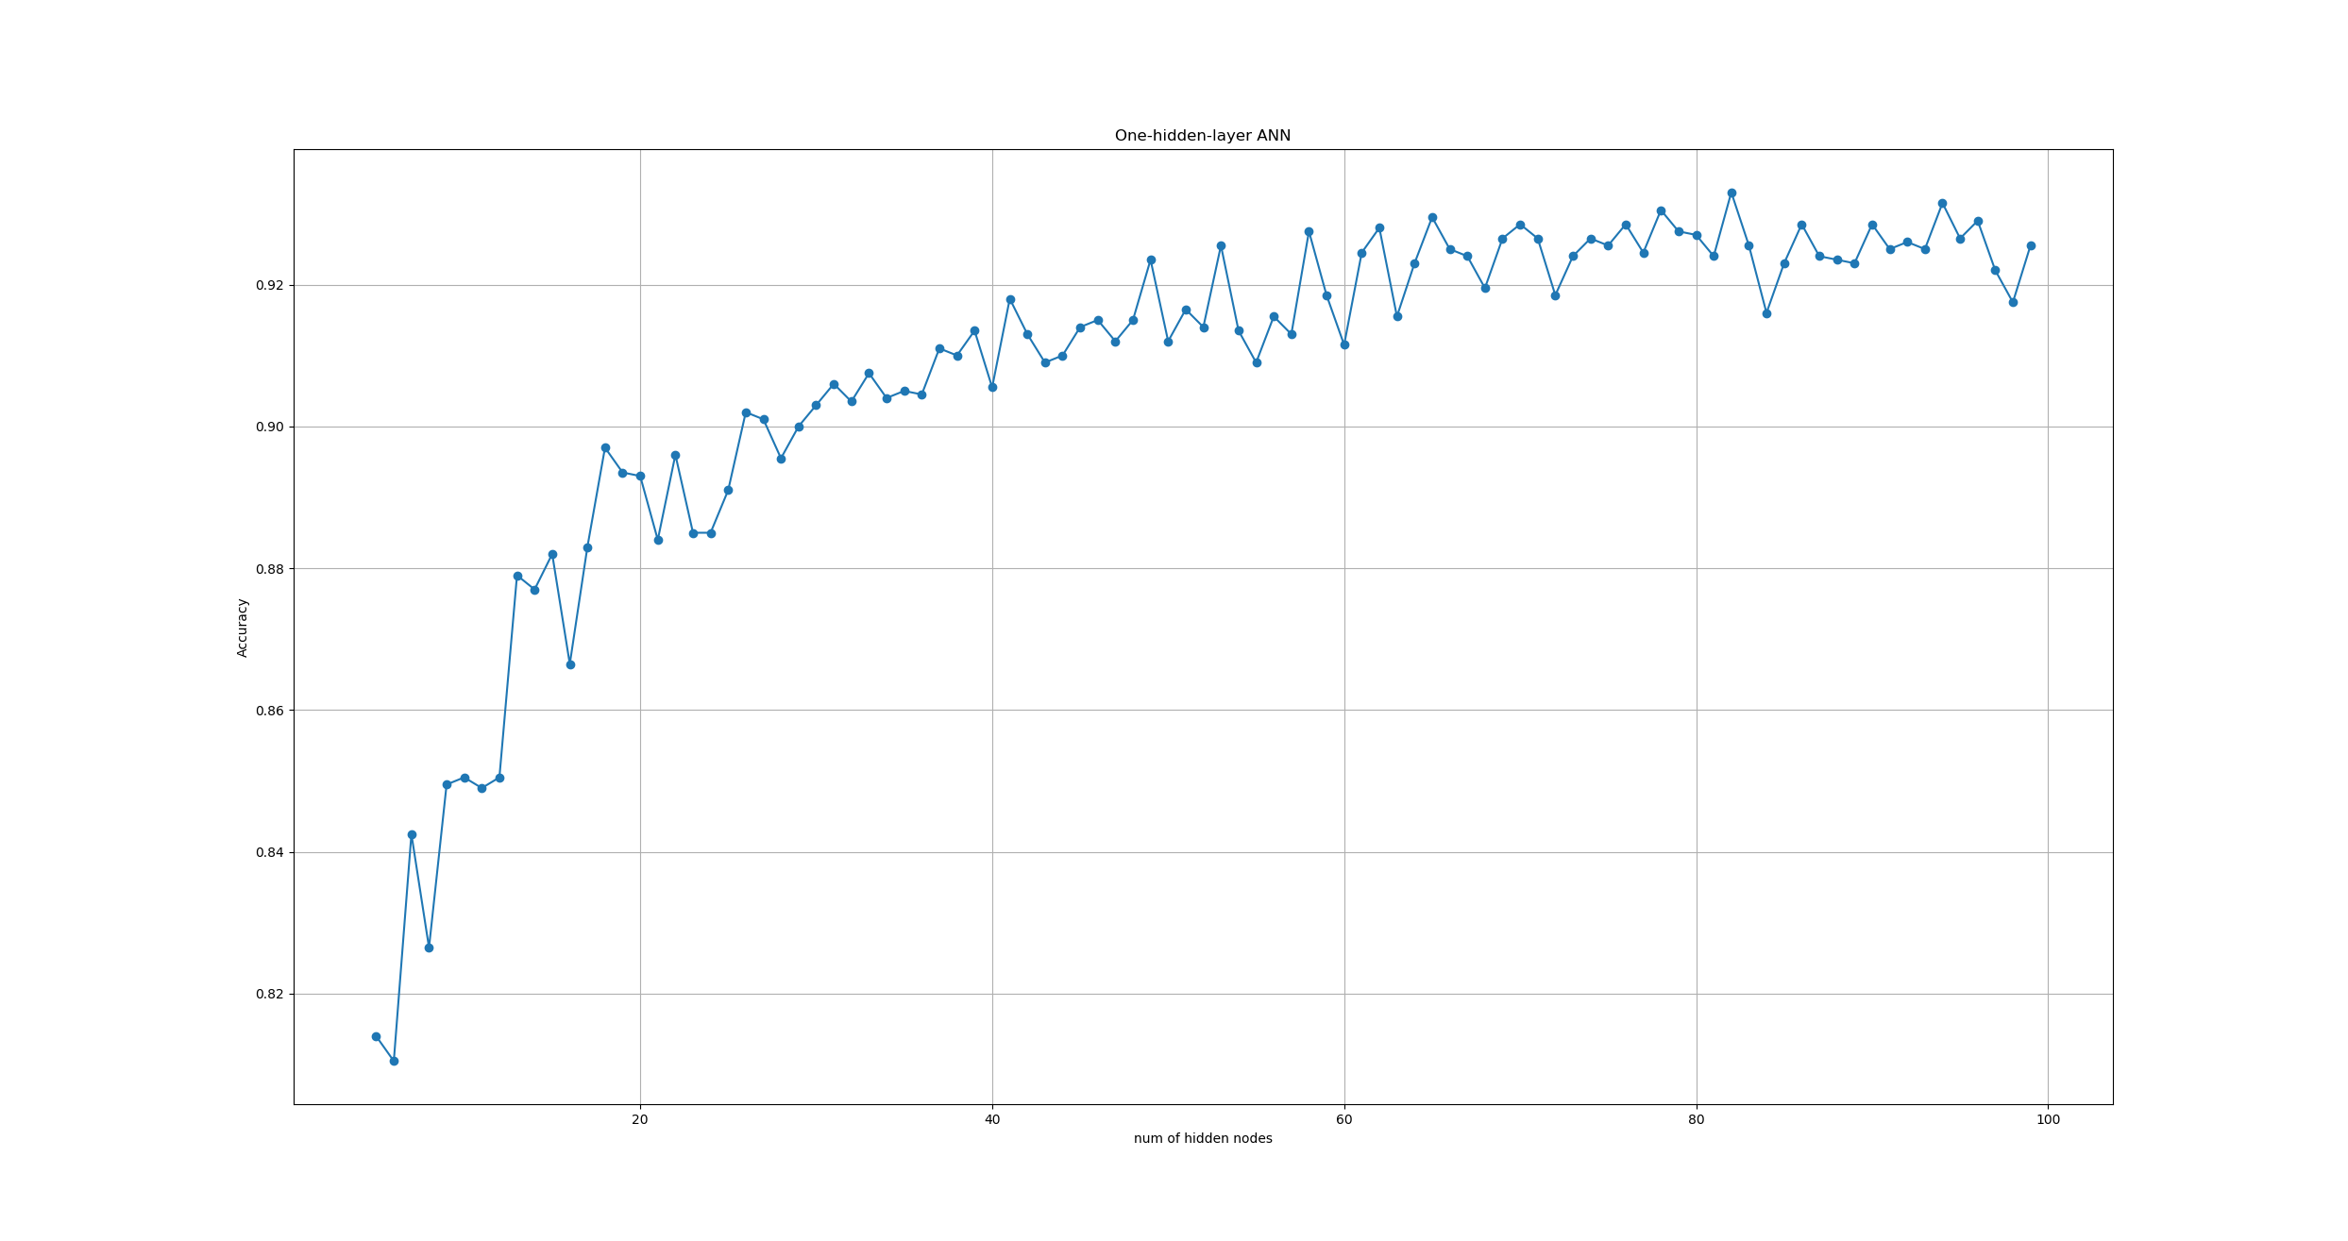
ANN

Slide 17
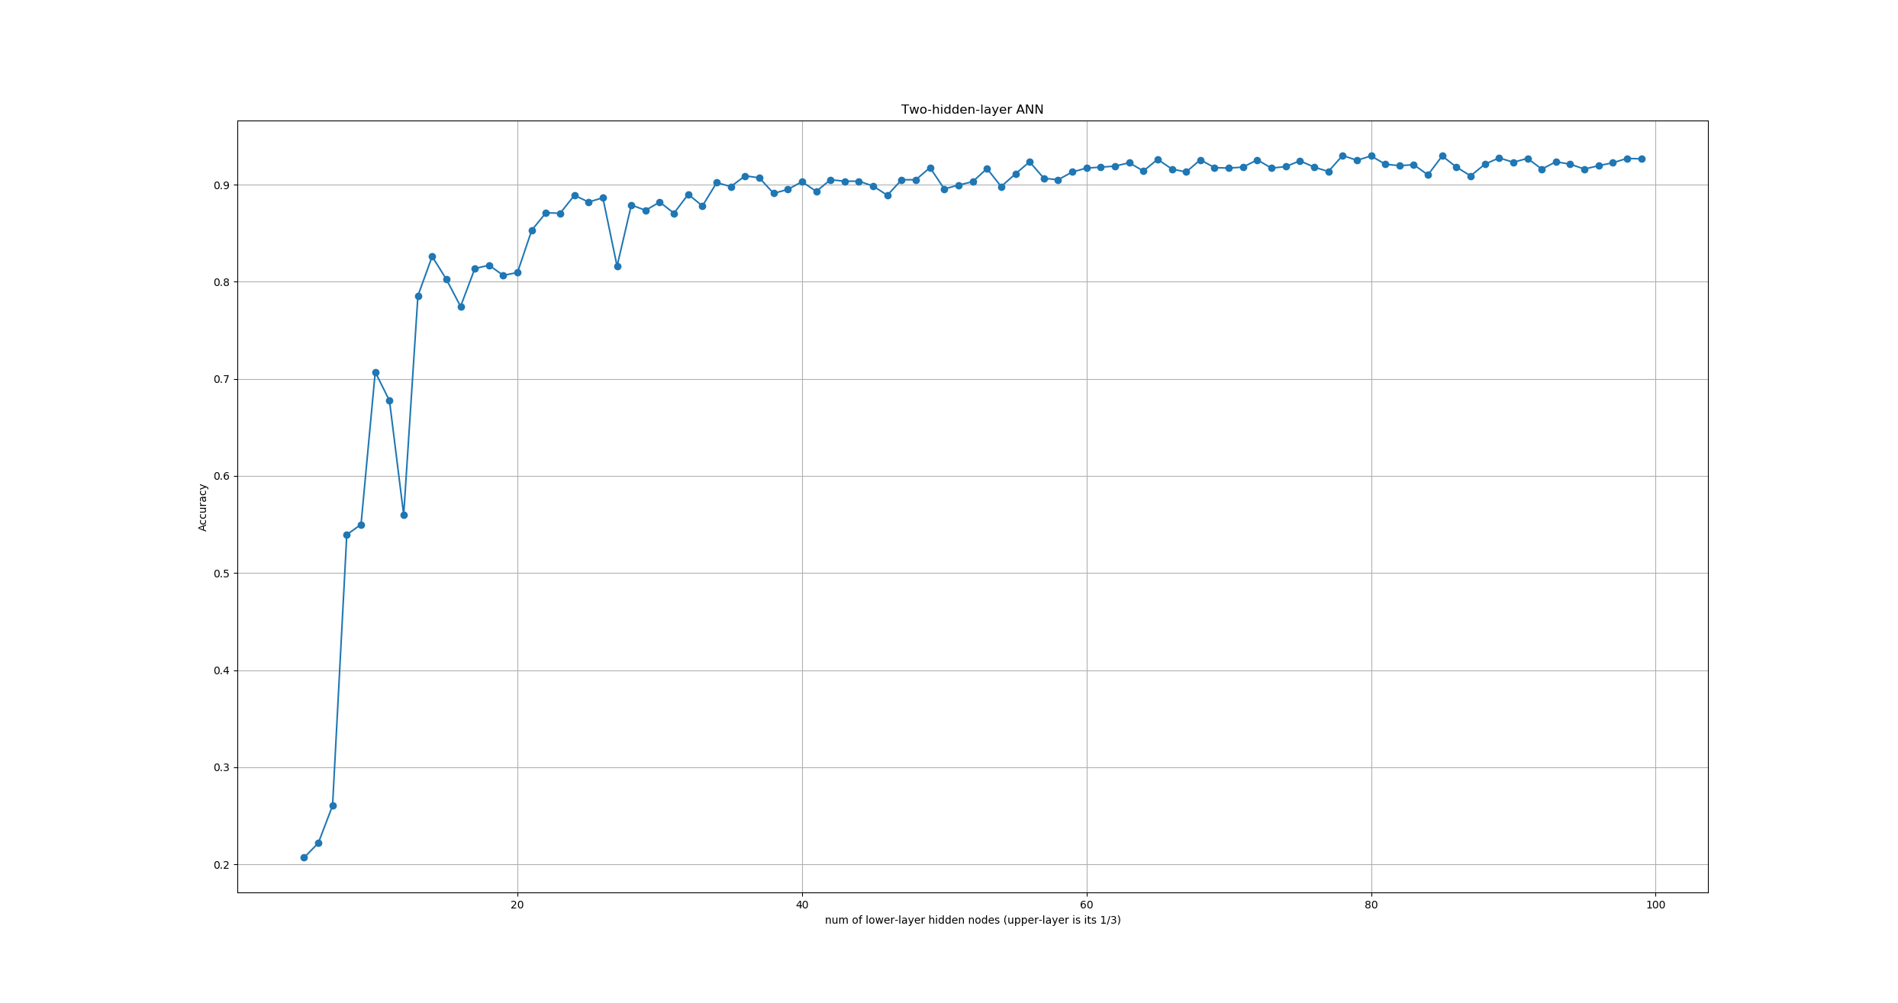
ANN

Slide 18
Task Allocation
Liyan Chen：
·Data collection & preprocessing
·Design SVM model
·Improve KNN model
·Feature extraction for CNN
·Comparing performance of different models
Shangxing Jiang：
·Data preprocessing
·Design KNN model
·Design ANN model
·Result Analysis

Slide 19
Thank you !

